Slide 1
Working With Json
SlideMake.com

Slide 2
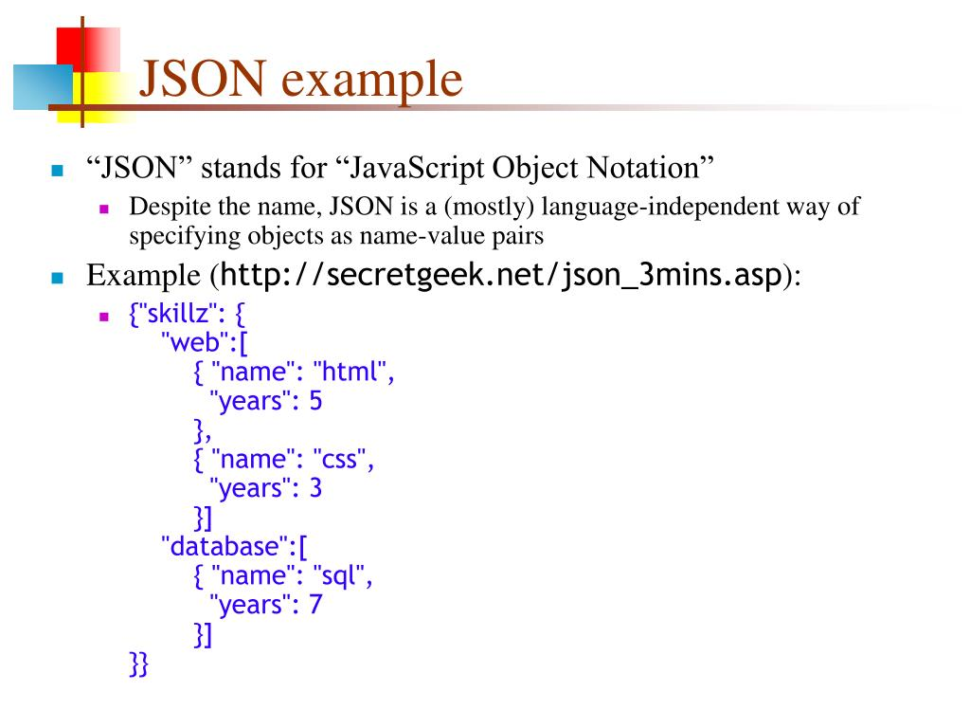
Introduction to JSON
JSON stands for JavaScript Object Notation and is a lightweight data interchange format.
It is easy for humans to read and write, and easy for machines to parse and generate.
JSON is language-independent, making it a popular choice for data exchange across different programming environments.
Notes:
Image source: https://gregoryboxij.blogspot.com/2021/03/38-introducing-javascript-object.html

Slide 3
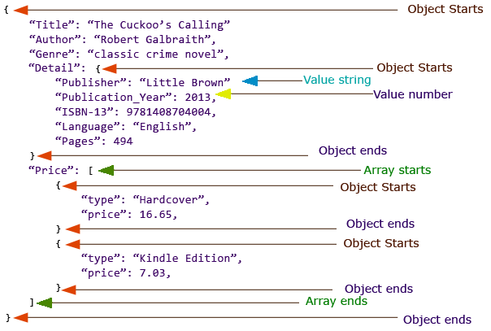
Structure of JSON
JSON data is represented as key-value pairs, similar to dictionaries or hash tables in other programming languages.
The structure consists of objects (enclosed in curly braces) and arrays (enclosed in square brackets).
Keys in JSON must be strings, while values can be strings, numbers, objects, arrays, booleans, or null.
Notes:
Image source: https://myjsonlearningweb.blogspot.com/

Slide 4
Common Uses of JSON
JSON is widely used in web APIs to transmit data between a server and a client.
It is also used in configuration files, allowing applications to store and retrieve settings easily.
Many databases, like MongoDB, use JSON-like formats to manage and query data efficiently.
Notes:
Image source: https://myjsonlearningweb.blogspot.com/

Slide 5
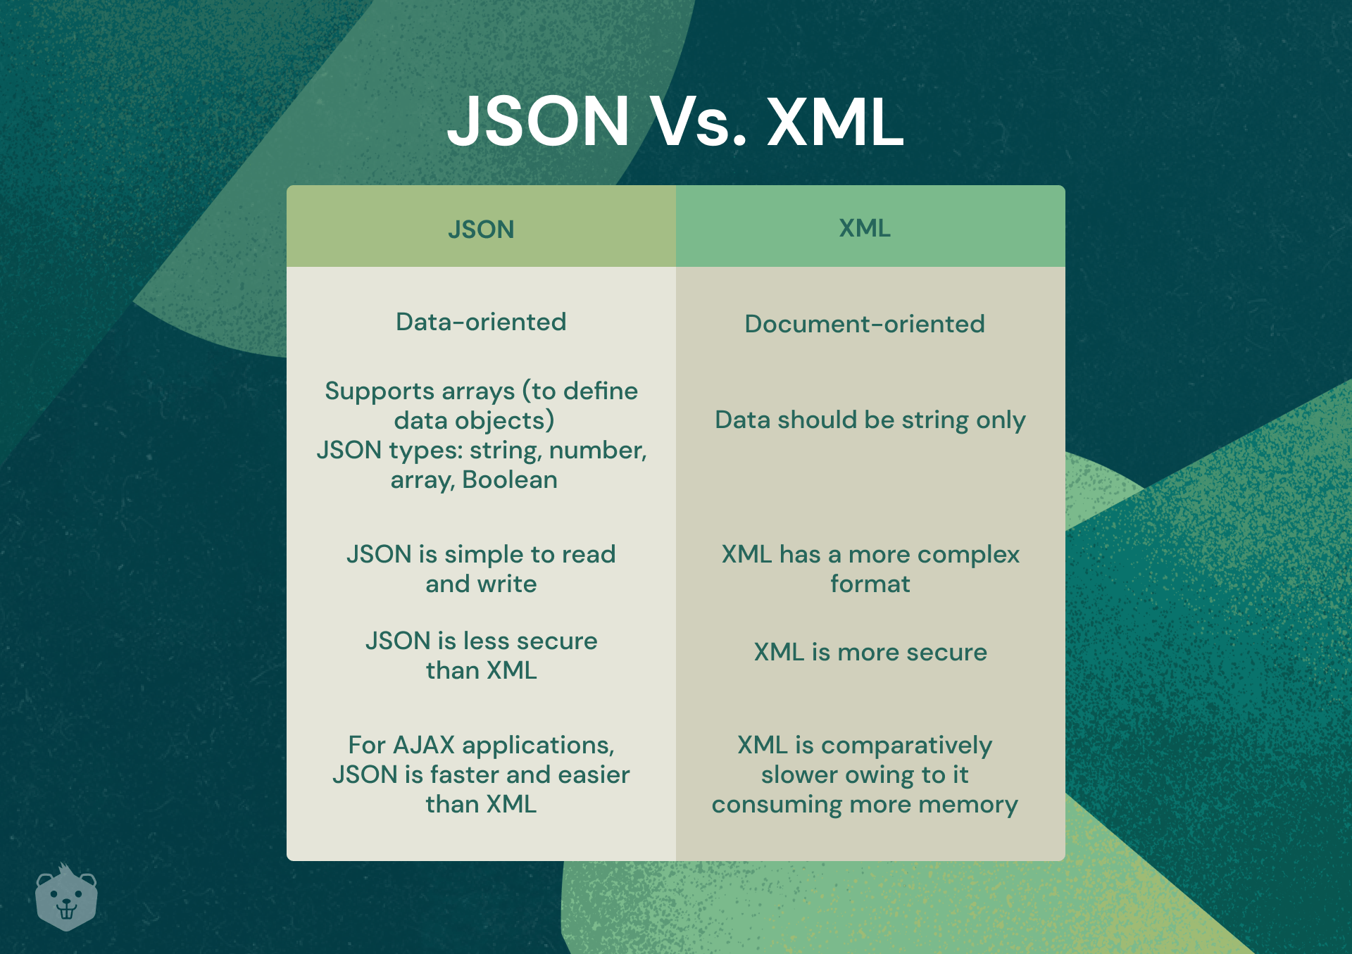
Advantages of JSON
JSON is lightweight compared to XML, which leads to faster parsing and data transmission.
It is easy to read and write, making it user-friendly for developers and non-developers alike.
JSON's compatibility with various programming languages enhances its versatility in software development.
Notes:
Image source: https://www.crio.do/blog/what-is-json/

Slide 6
JSON Syntax Rules
JSON syntax requires that keys must be enclosed in double quotes for valid formatting.
All string values must also be enclosed in double quotes, while numbers do not require quotes.
A JSON document must have a single top-level object or array to ensure proper structure.
Notes:
Image source: https://laptopprocessors.ru/check-if-response-is-json-python/

Slide 7
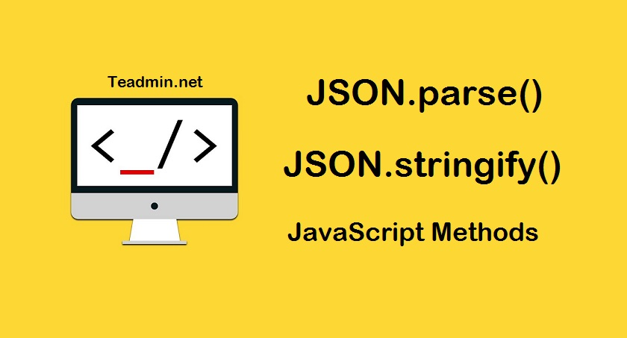
Parsing JSON in JavaScript
JavaScript provides built-in functions like JSON.parse() for converting JSON strings into JavaScript objects.
The JSON.stringify() function can be used to convert JavaScript objects back into JSON strings.
Understanding how to parse and stringify is essential for effective data manipulation in web applications.
Notes:
Image source: https://morioh.com/p/cee75f8a4d55

Slide 8
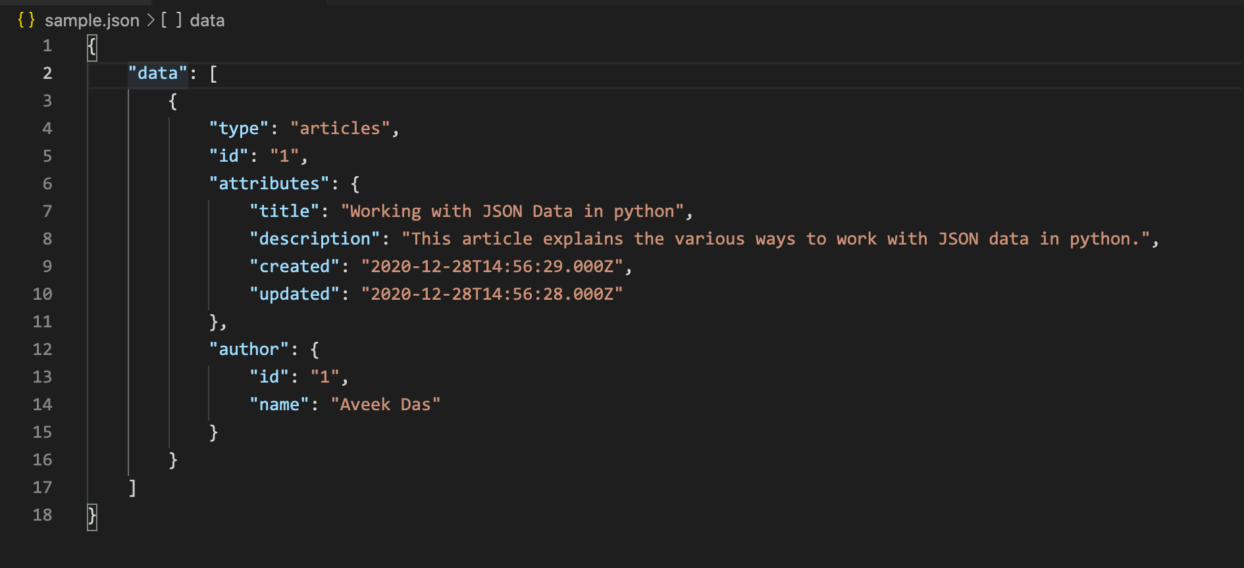
Working with JSON in Python
Python has a built-in module called 'json' that allows easy encoding and decoding of JSON data.
The json.loads() function converts JSON strings into Python dictionaries, while json.dumps() does the opposite.
This functionality is crucial for integrating web APIs and handling data in Python applications.
Notes:
Image source: https://www.vrogue.co/post/reading-and-writing-json-files-with-python-json-module-wellsr-com

Slide 9
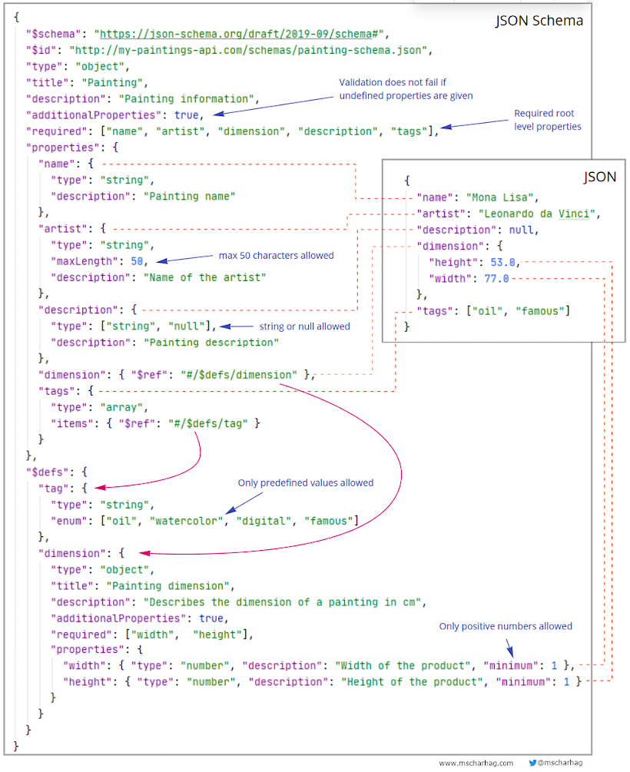
Validating JSON
Validating JSON ensures that the data adheres to the correct syntax and structure before processing.
Tools like JSONLint can be used to check for errors in JSON documents quickly.
Proper validation helps prevent runtime errors and improves data integrity in applications.
Notes:
Image source: https://www.javacodegeeks.com/2020/08/validating-and-documenting-json-with-json-schema.html

Slide 10
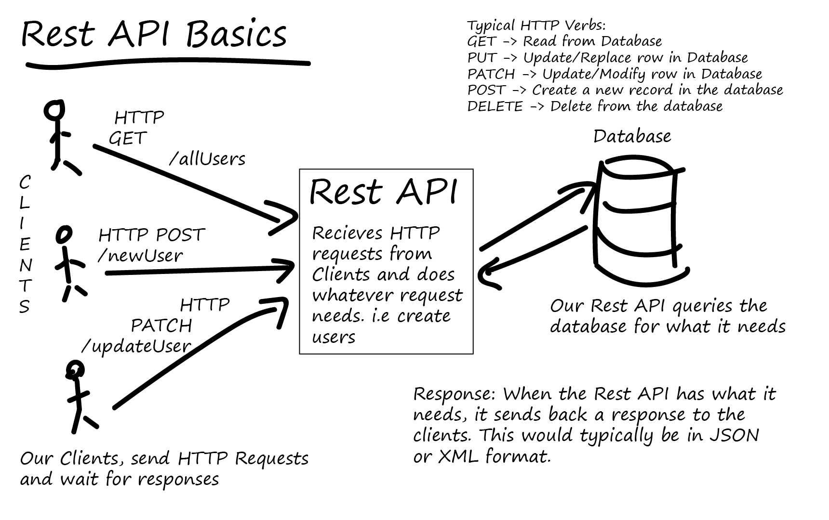
JSON and APIs
RESTful APIs commonly use JSON as the data format for requests and responses due to its simplicity.
Understanding how to format and parse JSON is vital for developers working with APIs.
JSON's popularity in APIs has led to a rich ecosystem of tools and libraries for various programming languages.
Notes:
Image source: https://www.spritely.net/decoding-rest-api-exploring-data-formats-beyond-json/

Slide 11
Conclusion
JSON is an essential format for data interchange in modern web development and applications.
Its simplicity, readability, and ease of use make it a preferred choice for many developers.
Mastering JSON is crucial for anyone working with data in a programming context, especially in web technologies.
Notes:
Image source: https://sudusoftware.com/format-data-json/

